Slide 1


Jorge Alberto Chavez Ponce
06/24/2024

Slide 2

Outline
Executive Summary
Introduction
Methodology
Results
Conclusion
Appendix

Slide 3
Executive Summary
Methodologies
Data was gathered using the SpaceX REST API (api.spacexdata.com/v4/launches/past). Python's requests library was used to perform GET requests, and json_normalize converted JSON data to a Pandas DataFrame. Wikipedia pages related to Falcon 9 launches were scraped using BeautifulSoup. HTML tables were extracted and converted into Pandas DataFrames. Additional details were gathered from other API endpoints (Boosters, Launchpads, payloads, cores) and integrated into the dataset. The dataset was filtered to focus on Falcon 9 launches. Missing values in PayloadMass were replaced with column mean values. Target variable Class was extracted from the dataset, and features were standardized using StandardScaler. Data was split into training (80%) and testing (20%) sets using train_test_split. EDA was conducted using SQL and various visualization techniques to identify trends and patterns in the data. Interactive maps were created to visualize launch and landing sites. Dashboards were developed to enable dynamic data exploration. Logistic Regression, Support Vector Machine (SVM), Decision Tree, and K-Nearest Neighbors (KNN) models were built. GridSearchCV with 10-fold cross-validation was used for tuning. Model performance was evaluated using accuracy, precision, recall, and F1-score. Confusion matrices were plotted for visual inspection.

Slide 4
Executive Summary
Results
Successful launches were most frequent in the 0-4000 kg payload range, while failures were more spread out but occurred more frequently below 2000 kg and above 4000 kg. The FT and B5 booster versions had higher success rates, especially within the 1000-4000 kg range, while the v1.0 and v1.1 versions showed more scattered results.
Model Performance:
Decision Tree: Achieved the highest classification accuracy.
Confusion Matrix: For the best-performing model (Decision Tree), true positives (TP) and true negatives (TN) were accurately predicted, with few false positives (FP) and false negatives (FN).

Slide 5
Introduction
The commercial space age has arrived, with companies like Virgin Galactic, Rocket Lab, Blue Origin, and SpaceX making space travel more affordable. SpaceX has achieved notable successes, such as:
Sending spacecraft to the International Space Station (ISS)
Developing Starlink, a satellite internet constellation
Conducting manned space missions
A key factor in SpaceX's cost-effectiveness is the reuse of the first stage of its Falcon 9 rockets, reducing launch costs to around $62 million compared to $165 million from other providers.
As a data scientist for Space Y, founded by billionaire Allon Musk, my tasks are:
Determine the Price of Each Launch:
Gather and analyze information about SpaceX launches.
Create dashboards to visualize cost components.
Predict the Reusability of the First Stage:
Use machine learning to predict if SpaceX will reuse the first stage based on public information.
These analyses will help Space Y compete with SpaceX by optimizing launch costs and strategies.

Slide 6

Section 1

Slide 7
Methodology
Executive Summary
Data Collection Methodology:
Gathered data from the SpaceX REST API (api.spacexdata.com/v4/launches/past).
Performed GET requests with the requests library to retrieve JSON data.
Used json_normalize to convert JSON data into a flat table.
Web scraped Wiki pages using BeautifulSoup to extract additional launch data.
Data Wrangling:
Integrated detailed data from additional API endpoints (Booster, Launchpad, payload, core).
Filtered out Falcon 1 launches to focus on Falcon 9.
Handled missing values by replacing NULLs in PayloadMass with the column's mean value.

Slide 8
Methodology
Executive Summary
Exploratory Data Analysis (EDA):
Conducted EDA using SQL and visualization techniques.
Generated summary statistics and visualizations to identify trends and patterns.
Interactive Visual Analytics:
Created interactive maps with Folium to visualize launch and landing sites.
Developed interactive dashboards with Plotly Dash for dynamic data exploration.
Predictive Analysis Using Classification Models:
Built and fine-tuned classification models (logistic regression, decision trees, svm) to predict first stage landings.
Evaluated models using accuracy, precision, recall, and F1-score.

Slide 9
Data Collection
SpaceX REST API
API Endpoint: api.spacexdata.com/v4/launches/past
Method: Used Python requests library to perform GET requests.
Data Format: JSON, converted to Pandas DataFrame using json_normalize.
Web Scraping
Source: Wikipedia pages related to Falcon 9 launches.
Method: Used BeautifulSoup to extract HTML tables.
Data Processing: Parsed HTML tables and converted to Pandas DataFrame.
Data Integration
Additional Endpoints: Used for detailed information on Boosters, Launchpads, payloads, and cores.
Method: Combined data from multiple endpoints to enrich dataset.
Data Cleaning
Filtering: Removed Falcon 1 launches to focus on Falcon 9.
Handling Missing Values: Replaced NULL values in PayloadMass with mean values.
One-Hot Encoding: Prepared categorical columns for analysis.

Slide 10
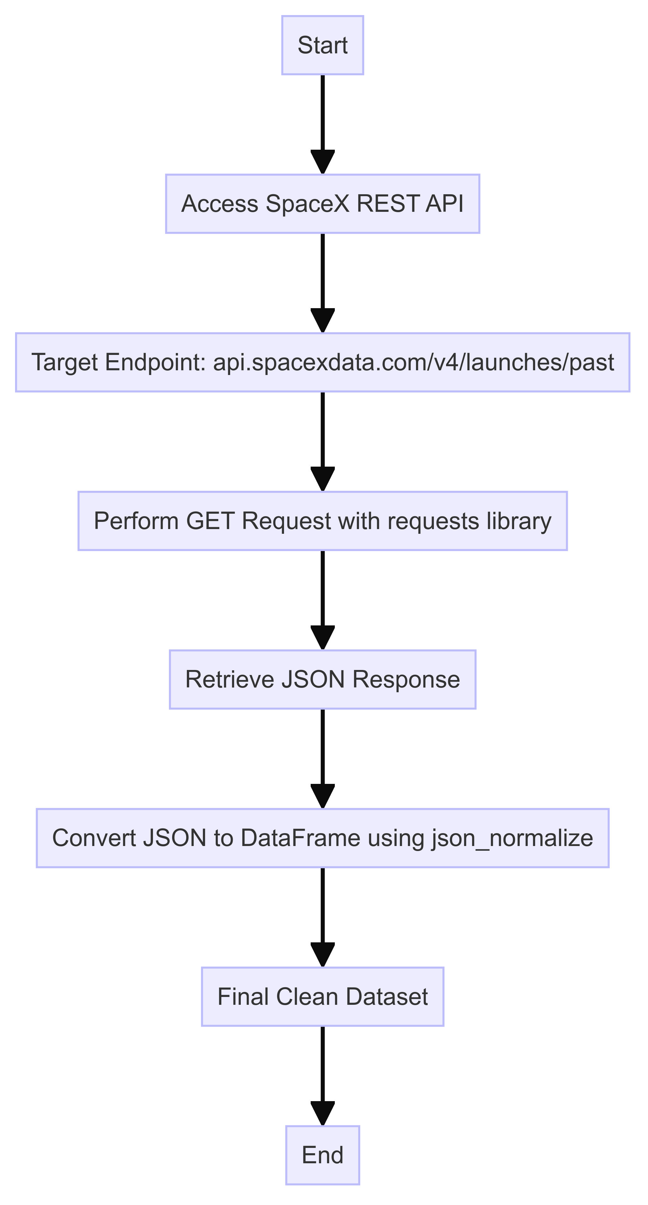
Data Collection – SpaceX API
Initiate Data Collection: Start by accessing the SpaceX REST API.
API Endpoint: Target endpoint api.spacexdata.com/v4/launches/past for past launches.
HTTP GET Request: Use Python requests library to perform GET requests.
Retrieve JSON Response: Obtain data in JSON format.
JSON to DataFrame: Convert JSON data to Pandas DataFrame using json_normalize
GitHub URL of the completed SpaceX API calls notebook:

Slide 11
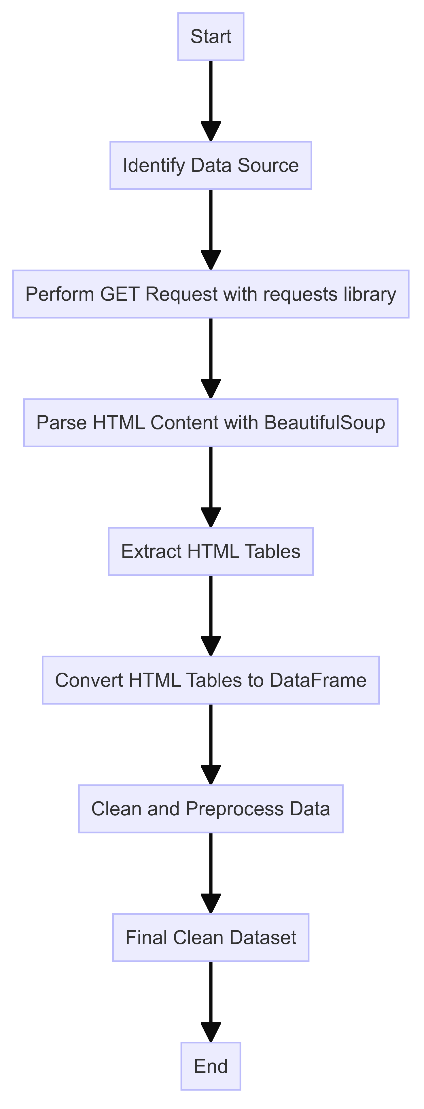
Data Collection - Scraping
Identify Data Source: Locate relevant Wikipedia pages for Falcon 9 launch data.
HTML Request: Use Python requests library to perform GET requests to the identified URLs.
Parse HTML Content: Utilize BeautifulSoup to parse the HTML content of the web pages.
Extract Data: Extract HTML tables containing launch records.
Convert to DataFrame: Convert the extracted tables into Pandas DataFrames.
Clean Data: Clean and preprocess the data for analysis.
GitHub URL of the completed web scraping notebook:

Slide 12
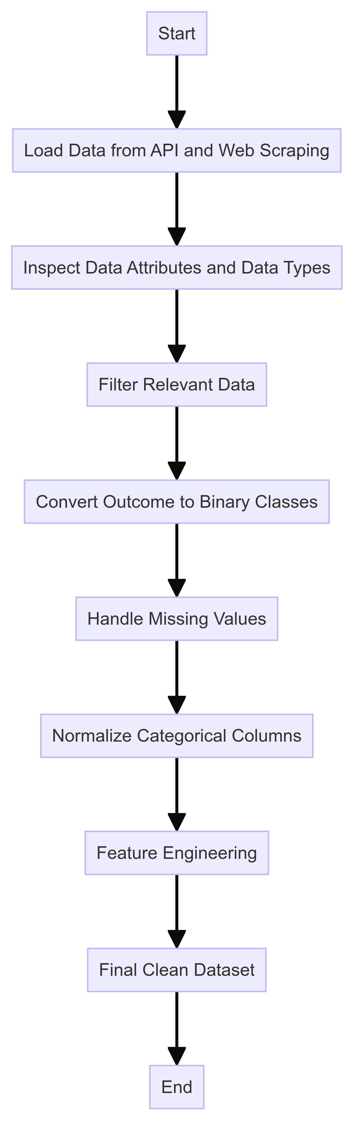
Data Wrangling
Data Attributes: Flight Number, Date, Booster Version, Payload Mass, Orbit, Launch Site, Outcome, Flights, Grid Fins, Reused, Legs, Landing Pad, Block, Reused Count, Serial, Longitude, Latitude.
Load Data: Import data from the SpaceX API and web scraping sources into a Pandas DataFrame.
Inspect Data: Review attributes and data types.
Filter Relevant Data: Focus on Falcon 9 launches and relevant columns.
Convert Outcome to Classes: Transform landing outcomes to binary classes (0 or 1).
Handle Missing Values: Replace NULL values in Payload Mass with the mean value.
Normalize Data: Use one-hot encoding for categorical columns like Launch Site and Orbits.
Feature Engineering: Create new features or modify existing ones to improve model performance.
Final Clean Dataset: Ensure data is clean and ready for analysis and modeling.
GitHub URL of data wrangling notebook:

Slide 13
EDA with Data Visualization
FlightNumber vs. PayloadMass with Launch Outcome Overlay:
Chart Type: Scatter Plot
Purpose: To show how flight experience (number of flights) and payload mass impact the success of the first stage landing.
FlightNumber vs. LaunchSite with Outcome Hue:
Chart Type: Categorical Plot (Catplot)
Purpose: To identify if certain launch sites have higher success rates based on flight number and outcome.
PayloadMass vs. LaunchSite:
Chart Type: Scatter Plot
Purpose: To highlight the distribution of payload masses at different launch sites and identify sites that do not handle heavy payloads.

Slide 14
EDA with Data Visualization
Success Rate by Orbit Type:
Chart Type: Bar Chart
Purpose: To compare the success rates across different orbit types and identify which orbits have higher or lower success rates.
FlightNumber vs. Orbit Type:
Chart Type: Line Chart
Purpose: To analyze how repeated launches to specific orbits affect success rates over time.
Year vs. Average Success Rate:
Chart Type: Line Chart
Purpose: To observe the trend in launch success rates over the years, indicating improvements or changes in success rates over time.
GitHub URL of EDA with data visualization notebook:

Slide 15
EDA with SQL
Display unique launch sites
Queried the distinct values in the Launch_Site column to identify unique launch sites.
Display total payload mass for NASA (CRS) launches
Queried the sum of PAYLOAD_MASS__KG_ for launches with Customer as 'NASA (CRS)'.
Display average payload mass for booster version F9 v1.1
Queried the average of PAYLOAD_MASS__KG_ for launches with Booster_Version as 'F9 v1.1'.
List date of first successful landing on ground pad
Queried the minimum Date where Landing_Outcome was 'Success'.
List boosters with successful drone ship landings and specific payload mass range
Queried distinct Booster_Version values where Landing_Outcome was 'Success' and PAYLOAD_MASS__KG_ was between 4000 and 6000 kg.

Slide 16
EDA with SQL
Display total number of successful and failed mission outcomes
Queried the count of records for Mission_Outcome 'Success'.
Queried the count of records for Mission_Outcome starting with 'Failure'.
List boosters carrying the maximum payload mass
Queried the Booster_Version with the maximum value of PAYLOAD_MASS__KG_.
List records with failure outcomes in 2015 with specific details
Queried the Month, Booster_Version, Launch_Site, and Landing_Outcome for records in 2015 with Landing_Outcome as 'Failure (drone ship)'.
Rank landing outcomes between specific dates
Queried the count of Landing_Outcome values grouped by outcome type, between '2010-06-04' and '2017-03-20', ordered by count in descending order.
GitHub URL of EDA with SQL notebook:

Slide 17
Build an Interactive Map with Folium
NASA Johnson Space Center Marker and Circle:
Marker: Located at NASA Johnson Space Center, Houston, Texas.
Circle: A circle with a radius of 1000 meters around the center.
Reason: To set a reference point for the map and mark NASA's Johnson Space Center.
Launch Sites Markers and Circles:
Markers and Circles: Added for each SpaceX launch site with coordinates from the launch_sites_df dataframe.
Reason: To visually mark the locations of all SpaceX launch sites on the map.
Launch Outcomes Markers (MarkerCluster):
Markers: Green markers for successful launches and red markers for failed launches.
Reason: To show the outcome of each launch at the respective launch sites, making it easy to identify success rates.

Slide 18
Build an Interactive Map with Folium
Distance to Coastline Marker and Line:
Marker: Shows the distance from the launch site to the closest coastline.
Line: A line drawn between the launch site and the coastline point.
Reason: To measure and visualize the proximity of the launch site to the coastline.
Distance to Railway Marker and Line:
Marker: Shows the distance from the launch site to the closest railway.
Line: A line drawn between the launch site and the railway point.
Reason: To measure and visualize the proximity of the launch site to a railway.
GitHub URL of completed interactive map with Folium map:

Slide 19
Build a Dashboard with Plotly Dash
Dropdown for Launch Site Selection:
Element: Dropdown menu.
Purpose: Allows the user to select a specific launch site or view data for all launch sites.
Interaction: When a user selects a launch site, the pie chart and scatter plot update to reflect the data for the selected site.
Pie Chart for Launch Success:
Element: Pie chart.
Purpose: Displays the total count of successful and failed launches.
Interaction: Updates based on the launch site selected in the dropdown. If "All Sites" is selected, it shows the success vs. failure counts for all sites combined. If a specific site is selected, it shows the success vs. failure counts for that site.

Slide 20
Build a Dashboard with Plotly Dash
Payload Range Slider:
Element: Range slider.
Purpose: Allows the user to filter the data based on the payload mass range.
Interaction: Updates the scatter plot to display data within the selected payload range.
Scatter Plot for Payload vs. Launch Success:
Element: Scatter plot.
Purpose: Shows the correlation between payload mass and launch success.
Interaction: Updates based on the selected launch site and the payload range. If "All Sites" is selected, it displays the correlation for all sites. If a specific site is selected, it shows the correlation for that site only.for all sites combined. If a specific site is selected, it shows the success vs. failure counts for that site.
GitHub URL of Plotly Dash lab:

Slide 21
Predictive Analysis (Classification)
1. Loading and Preparing Data
Load Data: Loaded datasets (dataset_part_2.csv and dataset_part_3.csv) into pandas DataFrames.
Extract Features and Labels: Extracted the target variable (Class) from the first dataset and the features from the second dataset.
Standardize Features: Standardized the features using StandardScaler from scikit-learn.
2. Splitting Data
Train-Test Split: Split the data into training (80%) and testing (20%) sets using train_test_split.

Slide 22
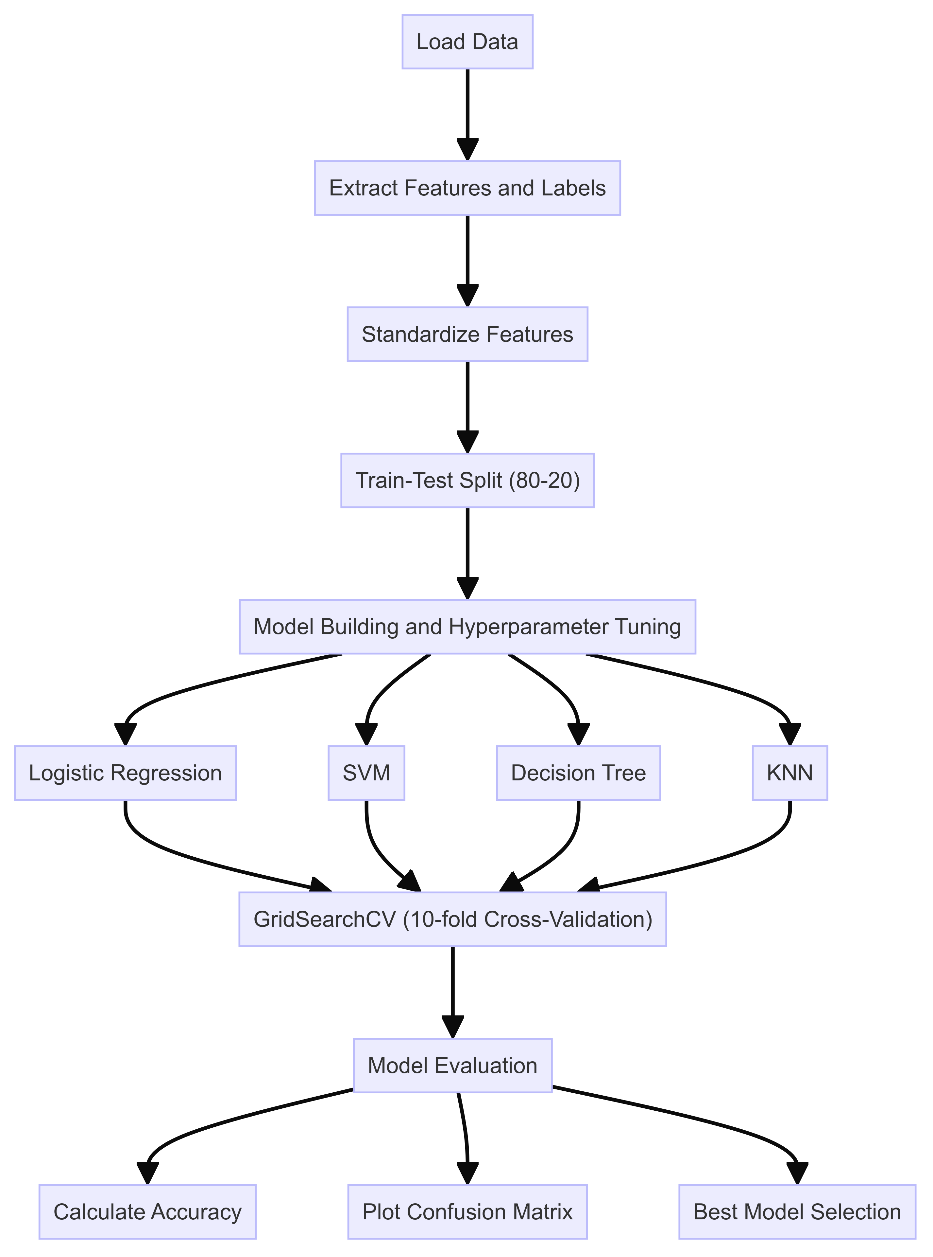
Predictive Analysis (Classification)
3. Model Building and Hyperparameter Tuning
Models: Logistic Regression, Support Vector Machine (SVM), Decision Tree, K-Nearest Neighbors (KNN)
Hyperparameter Tuning: Used GridSearchCV with 10-fold cross-validation to find the best parameters.
Evaluation: Evaluated model performance on test data and visualized results using a confusion matrix.
4. Model Evaluation and Selection
Accuracy Calculation: Calculated the accuracy for each model on the test set.
Confusion Matrix: Plotted confusion matrices for visual inspection of each model's performance.
Best Model Selection: Compared the accuracies and selected the model with the highest accuracy as the best performing model.
GitHub URL of Predictive Analysis lab:

Slide 23

Section 2

Slide 24
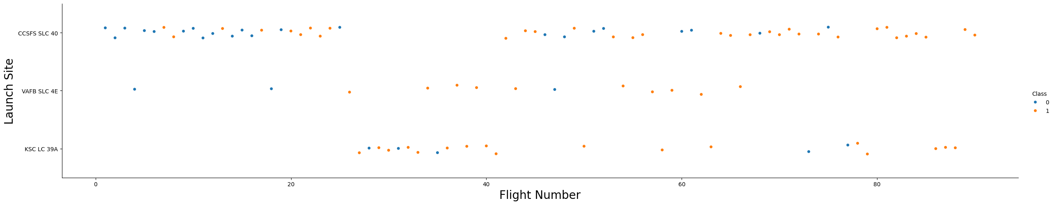
Flight Number vs. Launch Site
This scatter plot visualizes the relationship between flight numbers and launch sites. It can help identify patterns or trends in launch success rates at different sites over time.
Flight Number: Represents the sequence of launches.
Launch Site: Indicates where the launch took place.
Class (Hue): Differentiates successful and unsuccessful launches.
Insight: Observing the scatter plot might reveal if certain launch sites have a higher frequency of successful flights over time.

Slide 25
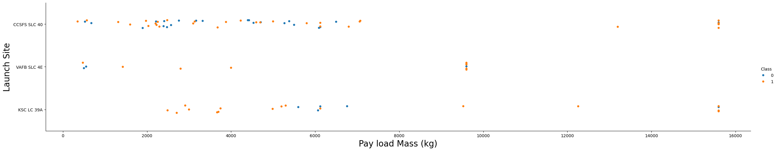
Payload vs. Launch Site
This scatter plot shows the relationship between the payload mass and the launch site, which can indicate if specific sites are used for heavier payloads.
Payload Mass: The mass of the payload being launched.
Launch Site: Indicates where the launch took place.
Class (Hue): Differentiates successful and unsuccessful launches.
Insight: This plot might show if certain launch sites handle heavier payloads and their corresponding success rates.

Slide 26
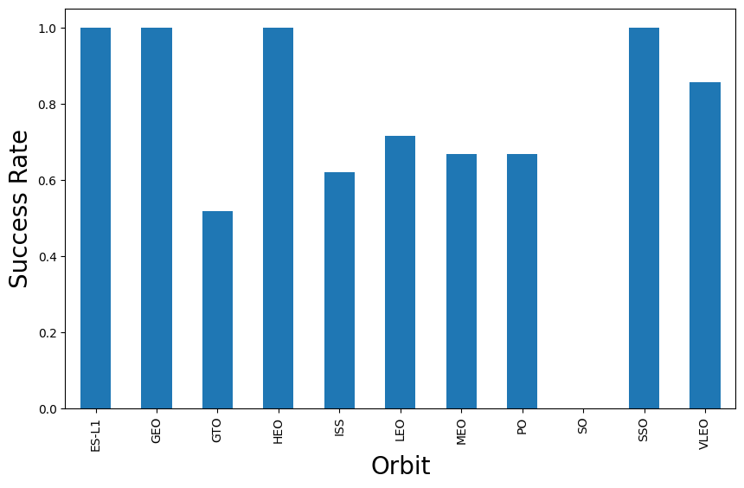
Success Rate vs. Orbit Type
This bar chart visualizes the success rates of different orbit types, helping to understand which orbits have higher chances of successful launches.
Orbit: Different types of orbits (e.g., LEO, GTO).
Success Rate: The average success rate for each orbit type.
Insight: This chart can highlight which orbits are more reliable for successful launches.

Slide 27
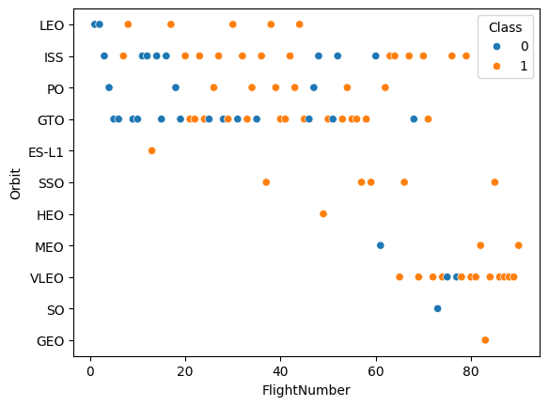
Flight Number vs. Orbit Type
This scatter plot shows the relationship between flight numbers and orbit types, which can reveal trends in launch success over time for different orbits.
Flight Number: Represents the sequence of launches.
Orbit: Different types of orbits.
Class (Hue): Differentiates successful and unsuccessful launches.
Insight: This plot might show how success rates vary across different orbit types over time.

Slide 28
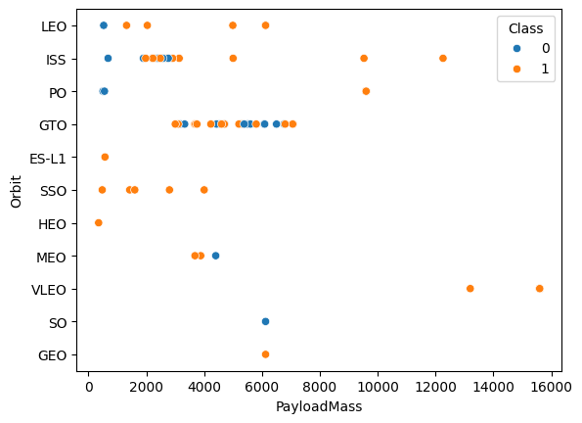
Payload vs. Orbit Type
This scatter plot visualizes the relationship between payload mass and orbit type, helping to identify trends in payload distribution across different orbits.
Payload Mass: The mass of the payload being launched.
Orbit: Different types of orbits.
Class (Hue): Differentiates successful and unsuccessful launches.
Insight: This plot might indicate which orbits are preferred for heavier or lighter payloads and their success rates.

Slide 29
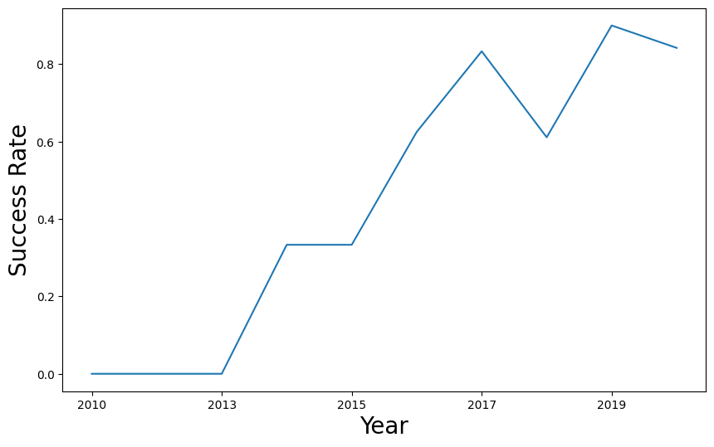
Launch Success Yearly Trend
This line chart shows the trend of average success rates over the years, providing a historical perspective on the improvement or decline in launch success.
Year: The year of the launch.
Success Rate: The average success rate for each year.
Insight: This chart can show the trend in launch success rates over time, indicating improvements or challenges in launch technology and operations.

Slide 30
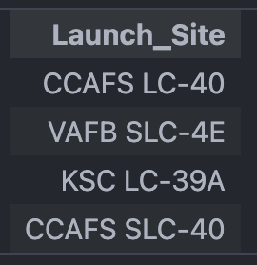
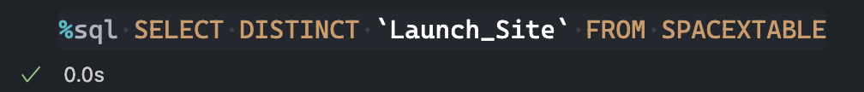
All Launch Site Names
Query:
A list of all unique launch sites from the SPACEXTABLE. This shows the various locations from which launches have been conducted.

Slide 31
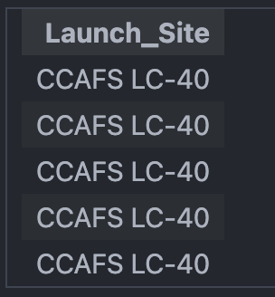
Launch Site Names Begin with 'CCA'
Query:
A list of launch sites from the SPACEXTABLE table that start with "CCA". This typically includes all launch sites located at Cape Canaveral.

Slide 32
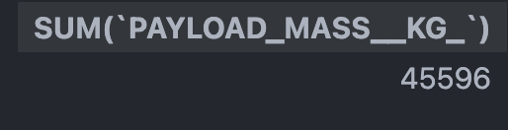
Total Payload Mass
Query:
The total payload mass (in kilograms) of all launches where the customer is 'NASA (CRS)'. This provides an aggregate figure for the amount of payload launched for NASA's Commercial Resupply

Slide 33
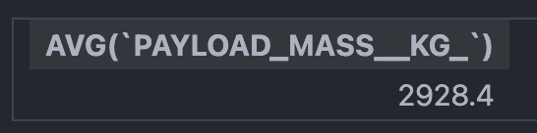
Average Payload Mass by F9 v1.1
Query:
The average payload mass (in kilograms) for launches using the 'F9 v1.1' booster version. This indicates the typical payload capacity for this specific version of the booster.

Slide 34

First Successful Ground Landing Date
Query:
The date of the first successful landing. This indicates when the first successful landing occurred in the dataset.

Slide 35
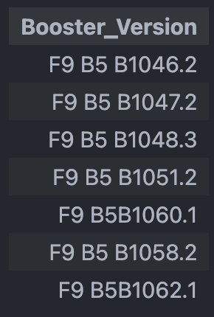
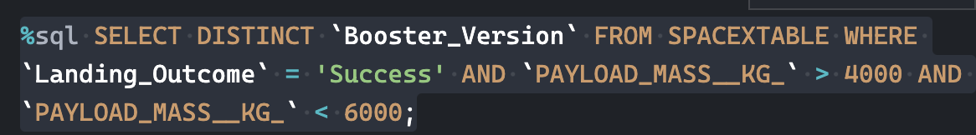
Successful Drone Ship Landing with Payload between 4000 and 6000
Query:
A list of unique booster versions that have successfully landed and carried a payload mass between 4000 kg and 6000 kg. This identifies which booster versions are capable of handling medium payloads and landing successfully.

Slide 36
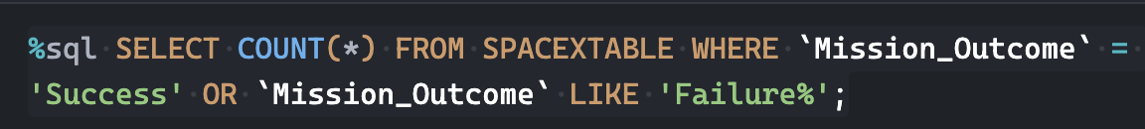
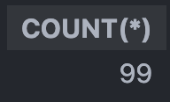
Total Number of Successful and Failure Mission Outcomes
Query:
The total number of launches that resulted in either a success or some form of failure. This provides a count of all recorded mission outcomes that were not indeterminate.

Slide 37
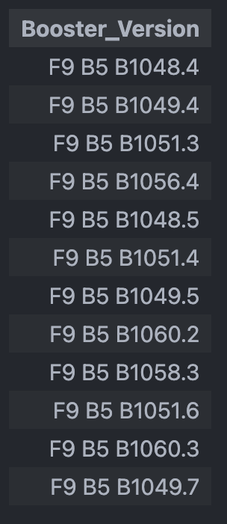
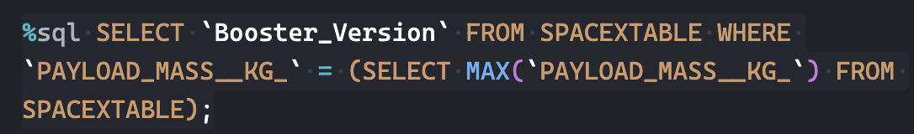
Boosters Carried Maximum Payload
Query:
The booster version that was used for the launch with the maximum payload mass. This identifies the specific booster version associated with the heaviest payload in the dataset.

Slide 38
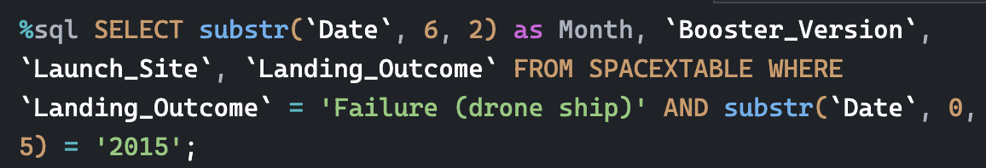
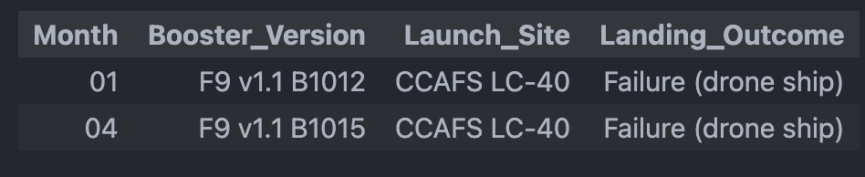
2015 Launch Records
Query:
A list of launches that failed on a drone ship in 2015, showing the month, booster version, launch site, and landing outcome. This provides details on specific failed landings on drone ships for the year 2015.

Slide 39
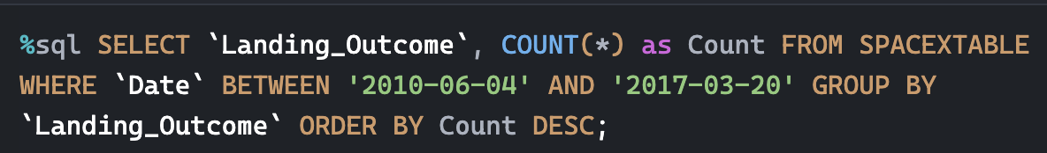
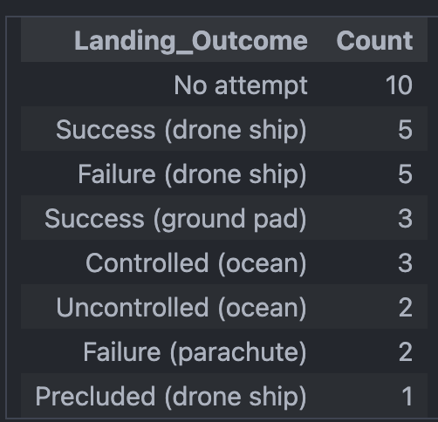
Rank Landing Outcomes Between 2010-06-04 and 2017-03-20
Query:
The count of each landing outcome between June 4, 2010, and March 20, 2017, ordered by the number of occurrences in descending order. This shows the frequency of different landing outcomes over the specified period.

Slide 40

Section 3

Slide 41
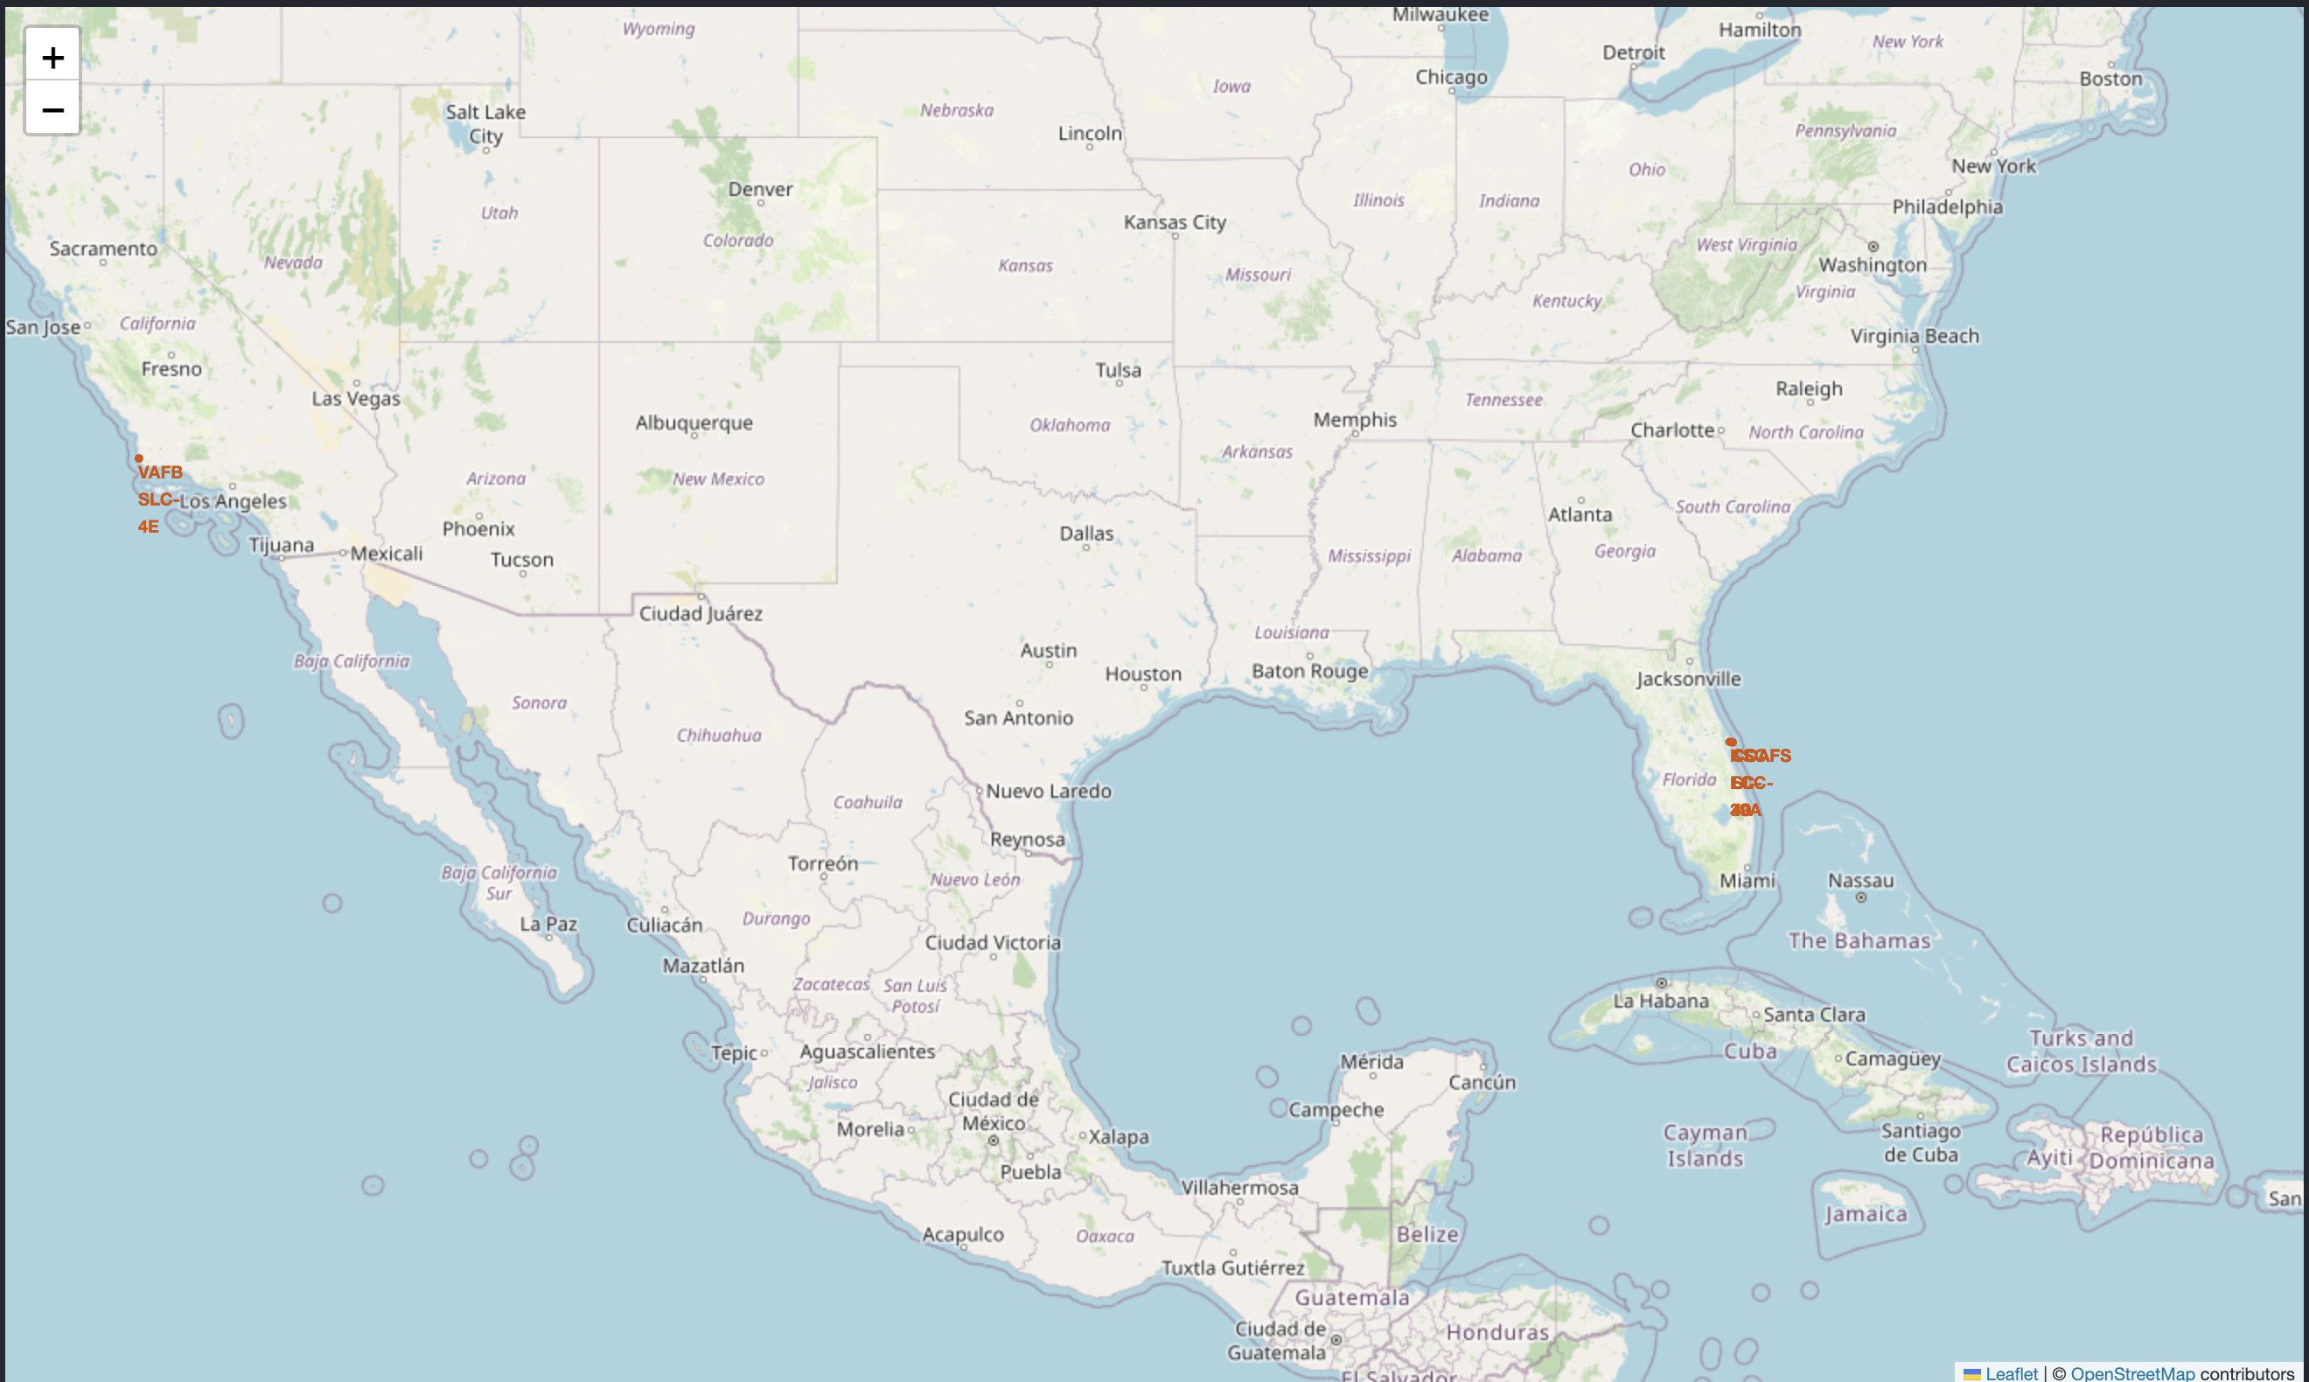
Marking Launch Sites on the Map
Objective: Identify the geographical locations of SpaceX launch sites.
Findings: The launch sites are located at:
CCAFS LC-40
CCAFS SLC-40
KSC LC-39A
VAFB SLC-4E
Observations: Most launch sites are close to the coast and relatively near the equator, which is advantageous for launching rockets into orbit due to the Earth's rotational speed.

Slide 42
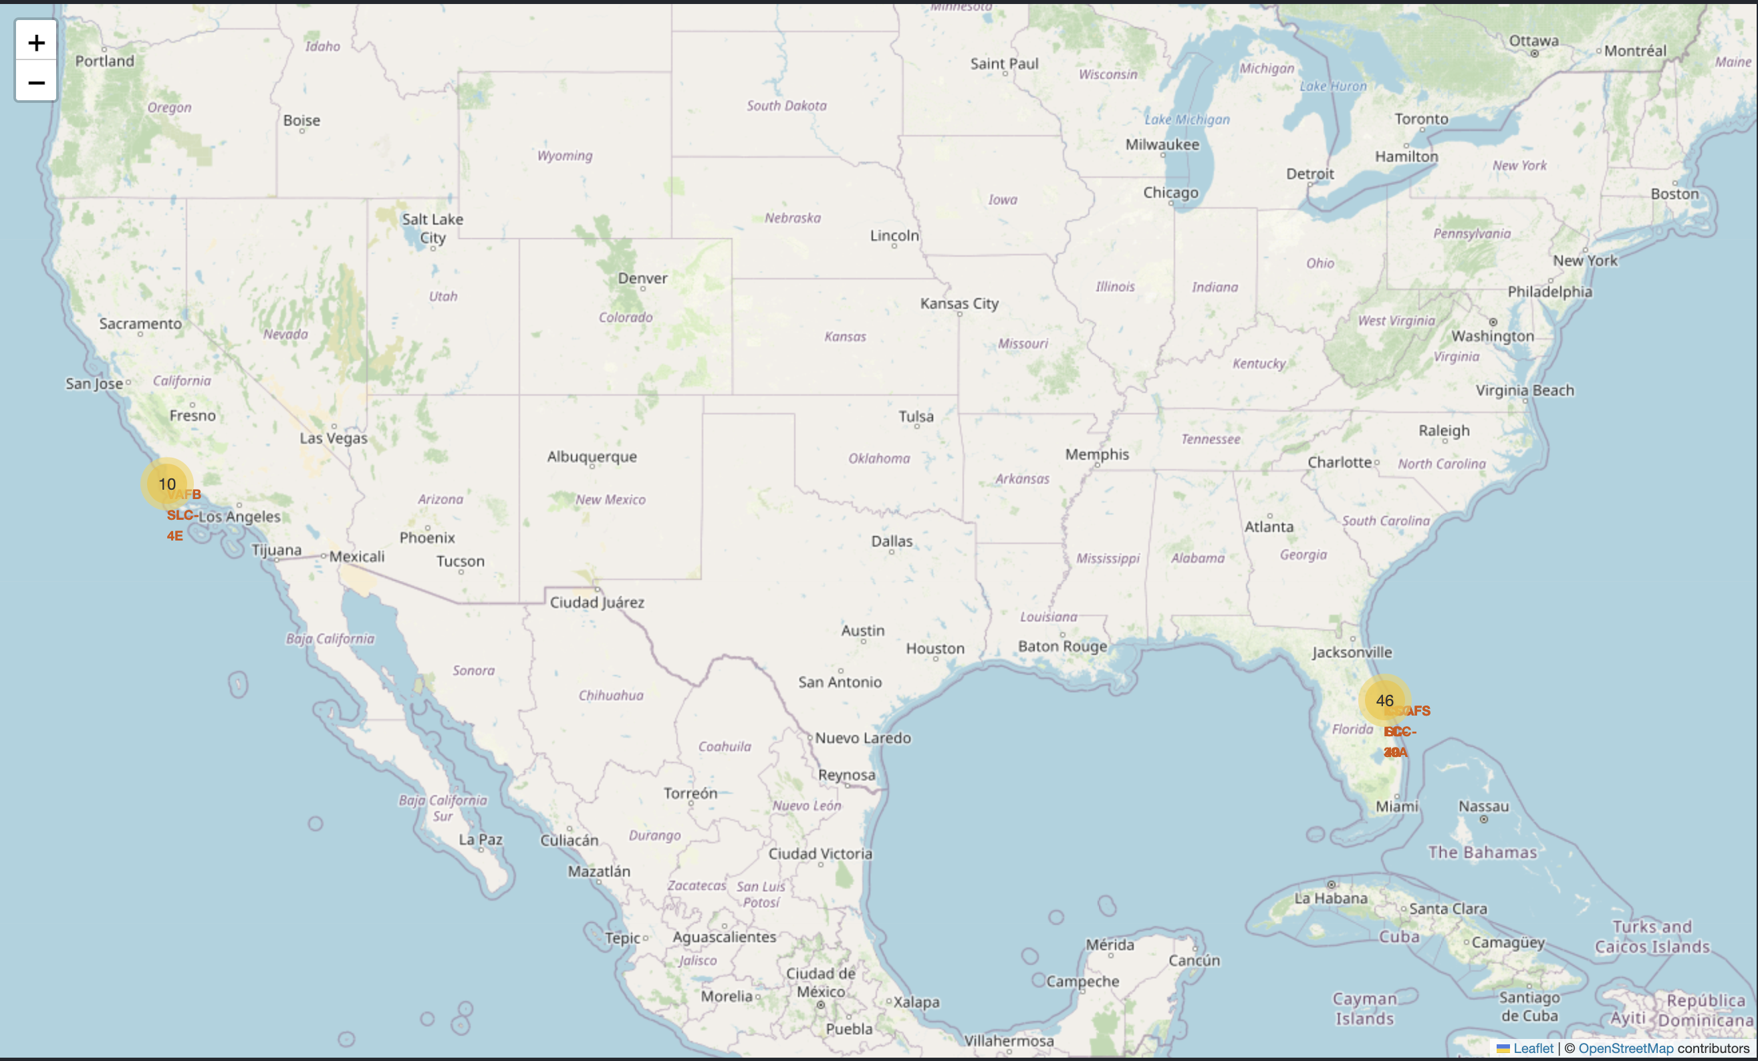
Marking Success/Failed Launches
Objective: Visualize the outcomes (success or failure) of launches at each site.
Findings: Each site is marked with green markers for successful launches and red markers for failed launches.
Observations: This visualization helps in identifying sites with higher success rates. For instance, if a site predominantly has green markers, it indicates a higher success rate compared to a site with more red markers.

Slide 43
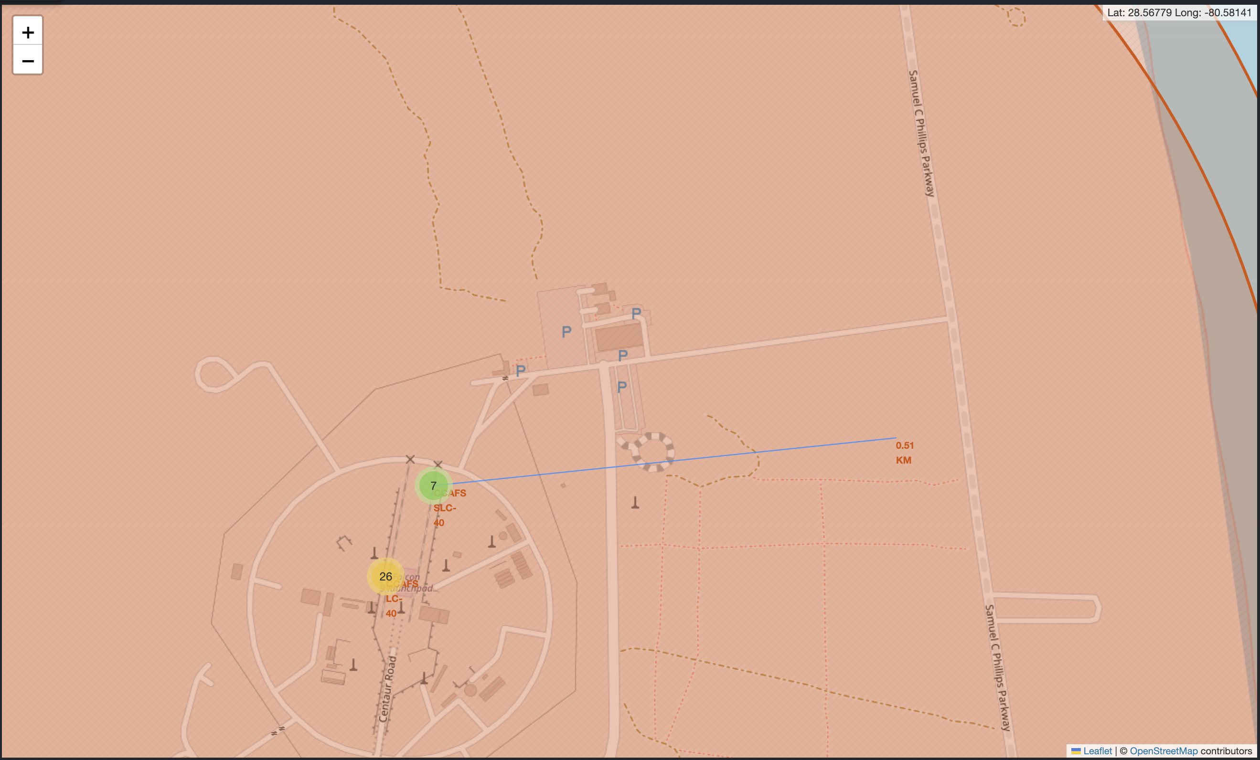
Calculating Distances to Proximities
Objective: Measure the distances between launch sites and their nearest significant features (e.g., coastlines, highways, railways).
Findings: The distance between CCAFS SLC-40 and its closest coastline is approximately 0.51 km.
Observations: Proximity to coastlines is crucial for safety and logistical reasons. The short distance to the coastline at CCAFS SLC-40 ensures quick transportation and minimal risk to populated areas.

Slide 44

Section 4

Slide 45
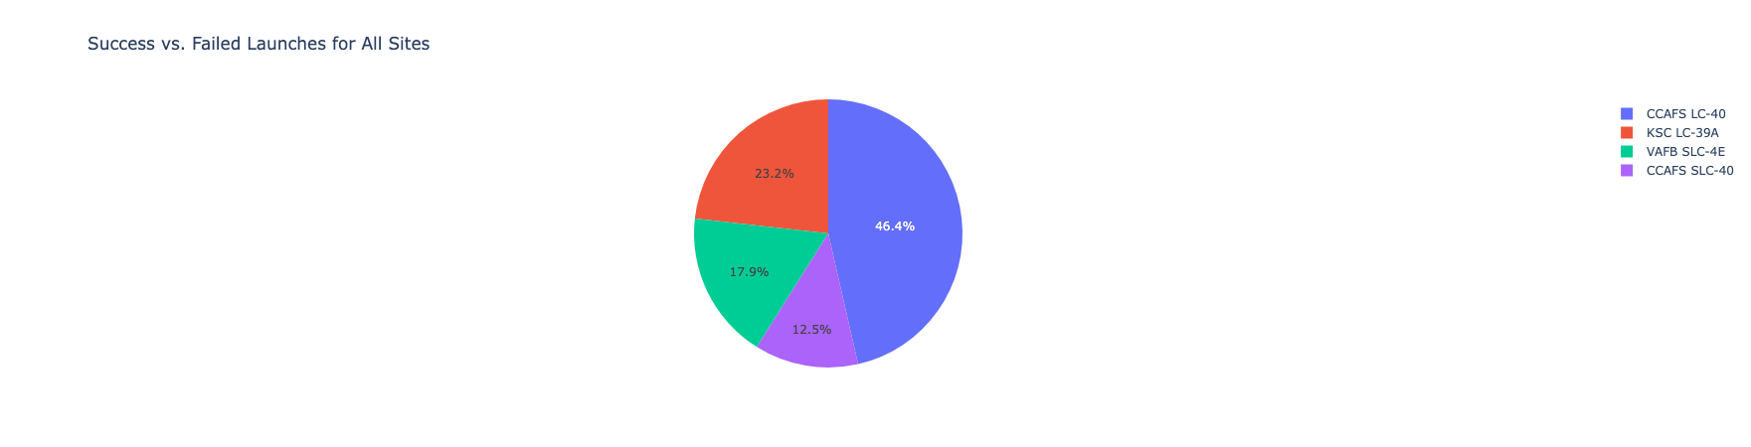
Success vs Failed Launches for All Sites
Indicates the data presented is a comparison of successful and failed launches across different launch sites.
CCAFS LC-40 has the highest number of launches, making up 46.4% of the total.
KSC LC-39A follows with 23.2%.
VAFB SLC-4E accounts for 17.9%.
CCAFS SLC-40 has the fewest launches at 12.5%.

Slide 46
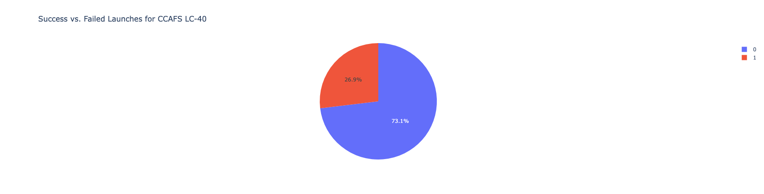
Success vs. Failed Launches for CCAFS LC-40
Focuses specifically on the success and failure rates of launches from the CCAFS LC-40 site.
Most launches from CCAFS LC-40 are successful, with a success rate of 73.1%.
The failure rate is 26.9%, indicating that just over a quarter of the launches failed.

Slide 47
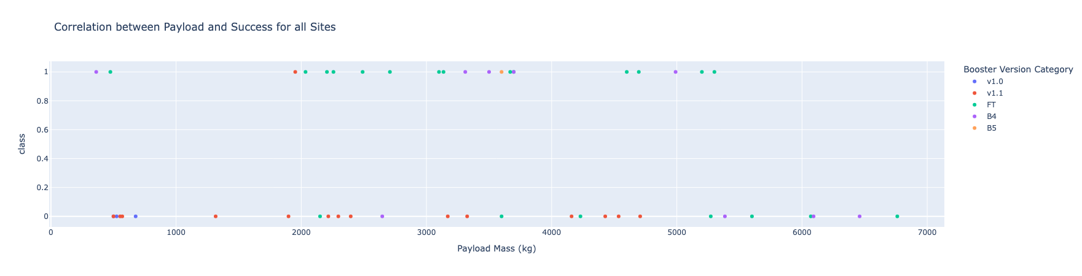
Correlation between Payload and Success for all Sites
Examines the relationship between payload mass and launch success across all sites.
Success Rates by Payload Range:
Most successful launches (class = 1) cluster in the 0-4000 kg payload range.
There are fewer successful launches for payloads above 4000 kg.
Failure Rates by Payload Range:
Launch failures (class = 0) are more spread out but tend to occur with payloads both below 2000 kg and above 4000 kg.
Booster Version Success:
FT and B5 versions appear to have higher success rates, especially within the 1000-4000 kg range.
v1.0 and v1.1 versions show more scattered successes and failures.
B4 has limited data points but shows success with payloads around 5000 kg.

Slide 48

Section 5

Slide 49
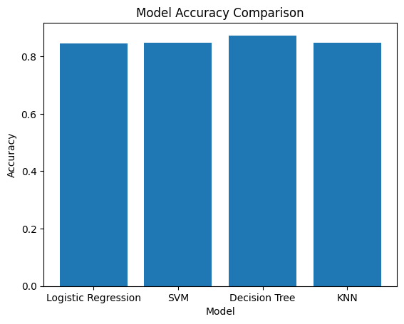
Classification Accuracy
The model has the highest classification accuracy is Decision Tree

Slide 50

Confusion Matrix
A confusion matrix is a table used to evaluate the performance of a classification model. Each row of the matrix represents the instances in an actual class, while each column represents the instances in a predicted class.
Specific Values:
Top-left (3): These are the true negatives (TN). The model correctly predicted that the rocket did not land for 3 instances.
Top-right (3): These are the false positives (FP). The model incorrectly predicted that the rocket landed for 3 instances that actually did not land.
Bottom-left (0): These are the false negatives (FN). The model incorrectly predicted that the rocket did not land for 0 instances that actually landed.
Bottom-right (12): These are the true positives (TP). The model correctly predicted that the rocket landed for 12 instances.

Slide 51
Conclusions
Most successful launches, indicated by a classification of 1, tend to fall within the payload range of 0-4000 kg. Conversely, there are fewer successful launches for payloads exceeding 4000 kg​
Among various classification models evaluated, including Logistic Regression, SVM, and KNN, the Decision Tree model achieved the highest classification accuracy for predicting the success of rocket landings
The FT and B5 booster versions demonstrate higher success rates, particularly for payloads within the 1000-4000 kg range. In contrast, the v1.0 and v1.1 versions show more scattered results, with successes and failures distributed more evenly
The analysis found that the distance to the nearest coastline is a significant factor, with the CCAFS SLC-40 launch site being only approximately 0.51 km from the coastline. This proximity is vital for both safety and logistical reasons​
The best model accurately predicted 12 successful landings out of 12 actual successful landings, indicating strong performance in identifying when a rocket will land.

Slide 52
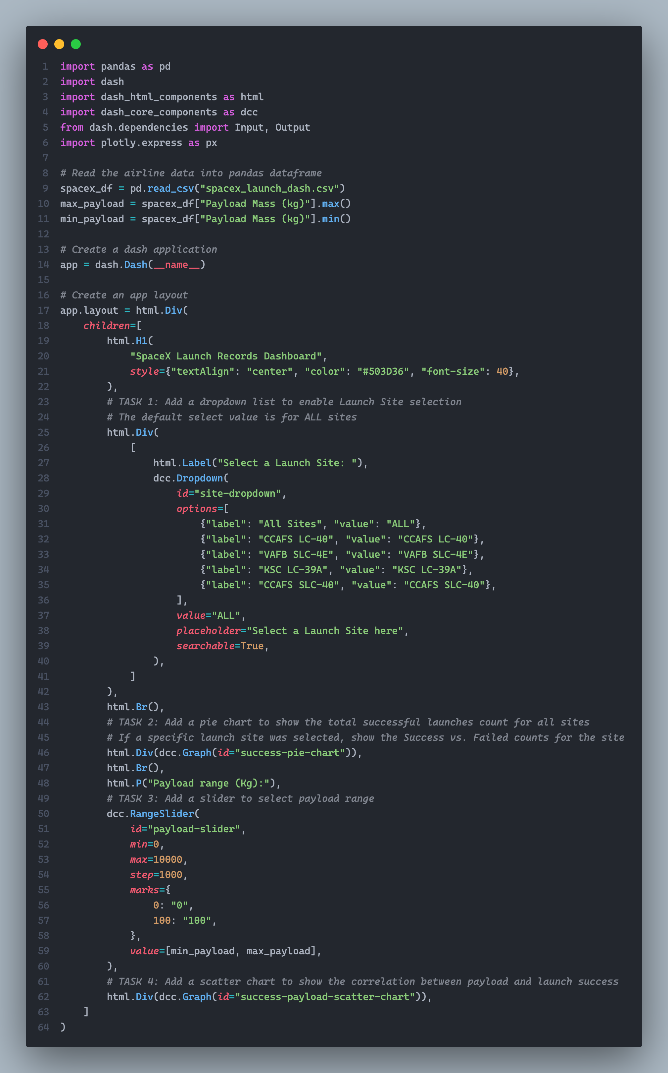
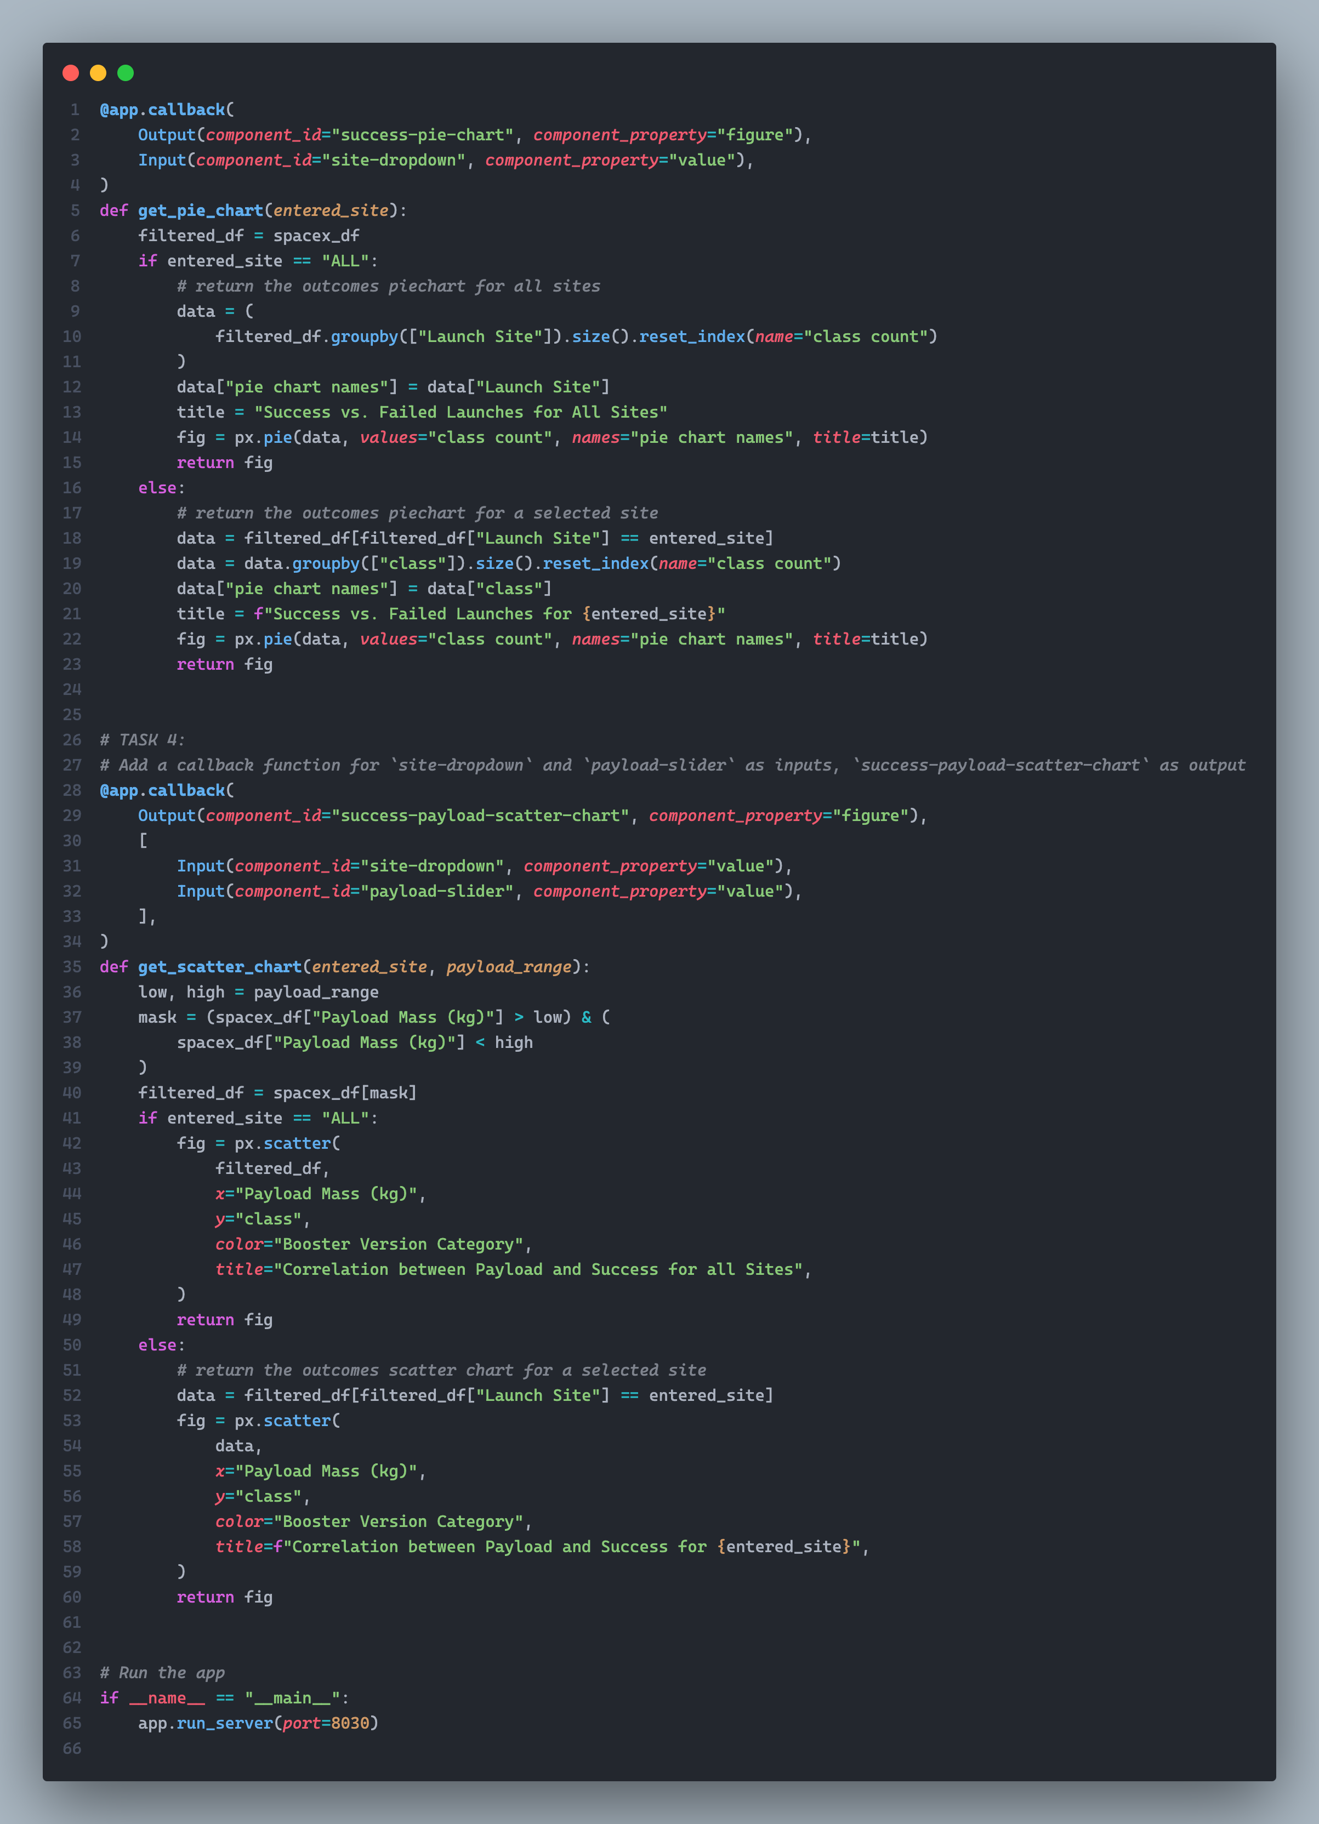
Appendix
Python code for the dashboard with Plotly

Slide 53


